Slide 1
  RULES
  AND
  REGULATIONS

Slide 2


Pay attention.
YOU CAN’T SMOKE.
YOU HAVE TO STOP.
Notes:
TEACHER: Ask students to look at the pictures and read the sentences.

Slide 3
Answer.
CAN’T and HAVE TO are called MODAL VERBS. | CAN’T means: ( ) something is not permitted. ( ) something is permitted. HAVE TO means: ( ) something is optional. ( ) something is obligatory.
Notes:
TEACHER: Have students reflect about the signs and the meaning of the rules.

Slide 4
Check.
CAN’T means: * Something is not permitted. | HAVE TO means: * Something is obligatory.
There are other modal verbs with different meanings:
SHOULD / SHOULDN’T – something is advisable or not.
DON’T HAVE TO – something is not necessary.
Notes:
TEACHER: Have students check the correct answers. Draw students’ attention to the other modals presented. Practice the modals with some rules in the classroom.

Slide 5

Pay attention.
* Modal verbs can be used in rules and regulations.
* They’re always followed by verbs in the base form.
* They are used in the same form with all subjects.
Notes:
TEACHER: Explain to students some important aspects of modal verbs.

Slide 6
Pay attention.
INTERROGATIVE
Can I watch TV now? Can you watch TV now? Can he watch TV now? Can she watch TV now? Can it watch TV now? Can we watch TV now? Can you watch TV now? Can they watch TV now? | Should I study verbs? Should you study verbs? Should he study verbs? Should she study verbs? Should it stop? Should we study verbs? Should you study verbs? Should they study verbs? | Do I have to pay? Do you have to pay? Does he have to pay? Does she have to pay? Does it have to pay? Do we have to pay? Do you have to pay? Do they have to pay?
Notes:
TEACHER: Draw students’ attention to the chart and have them notice the interrogative form.

Slide 7
Pay attention.
NEGATIVE
I can’t watch TV now. You can’t watch TV now. He can’t watch TV now. She can’t watch TV now. It can’t watch TV now. We can’t watch TV now. You can’t watch TV now. They can’t watch TV now. | I shouldn’t rest now. You shouldn’t rest now. He shouldn’t rest now. She shouldn’t rest now. It shouldn’t stop. We shouldn’t rest now. You shouldn’t rest now. They shouldn’t rest now. | I don’t have to pay. You don’t have to pay. He doesn’t have to pay. She doesn’t have to pay. It doesn’t have to pay. We don’t have to pay. You don’t have to pay. They don’t have to pay.
Notes:
TEACHER: Draw students’attention to the chart and have them notice the negative form.

Slide 8

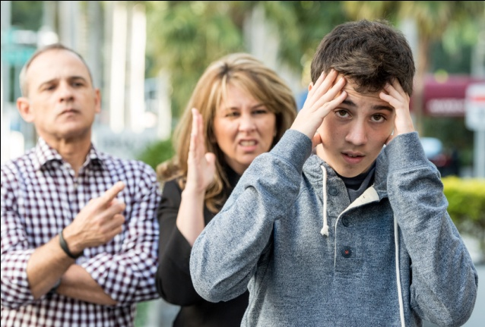



Now, you!
Notes:
TEACHER: Have students think about possible sentences related to the pictures.

Slide 9



Check.
We can’t use our cell phones.
We can’t eat or drink here.
We can’t bring our dogs.
Notes:
TEACHER: Ask students to check some possible rules related to each picture. These are some suggestions, there may be other ways of expressing the rules.

Slide 10


Check.
You have to study harder.
You should be quiet here.
Notes:
TEACHER: Ask students to check some possible rules related to each picture. These are some suggestions, there may be other ways of expressing the rules.

Slide 11
Complete.
At school | At home
I have to... I don’t have to... I can... I can’t... I should... I shouldn’t... | I have to... I don’t have to... I can... I can’t... I should... I shouldn’t...
Notes:
TEACHER: Ask students to complete the chart with the rules they have at school and at home. When they finish, have them share their rules with a partner and check what they have in common.

Slide 12
Well done!

